Slide 1

Using Reinforcement Learning to Train a Tetris Agents
Luc Dupuy
Jonathan Lorayes
Alfred Sung
Notes:
Adam & Luc, Adam leads

Slide 2
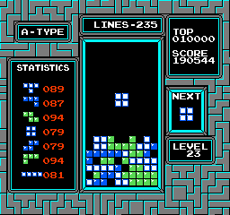
How To Play Tetris

Slide 3
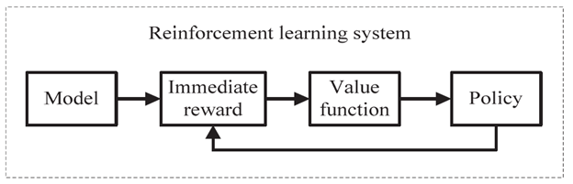
Reinforcement Learning
Shyalika, Chathurangi. “A Beginners Guide to Q-Learning.” Medium, Towards Data Science, 16 Nov. 2019, towardsdatascience.com/a-beginners-guide-to-q-learning-c3e2a30a653c.
Notes:
Talk about the basics of Q Learning

Slide 4
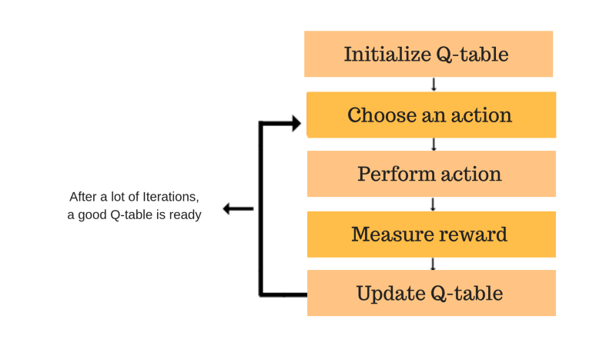
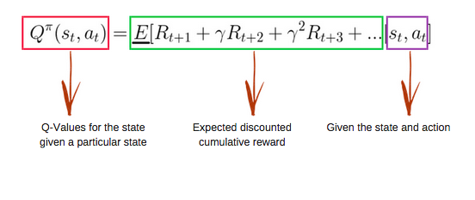
Q-Learning
freeCodeCamp.org. “An Introduction to Q-Learning: Reinforcement Learning.” FreeCodeCamp.org, FreeCodeCamp.org, 9 Aug. 2018, www.freecodecamp.org/news/an-introduction-to-q-learning-reinforcement-learning-14ac0b4493cc/.
Notes:
Talk about the basics of Q Learning

Slide 5
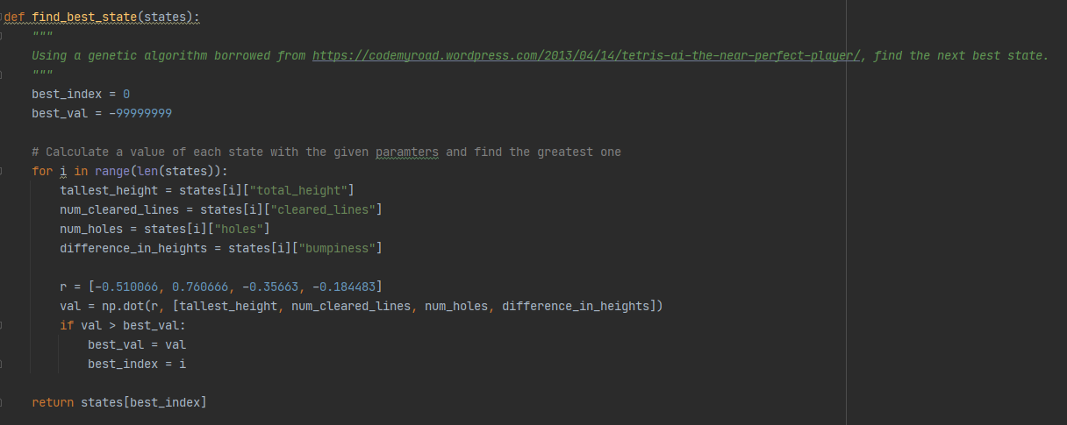
Code Sample
Notes:
Eventually will show q learning code

Slide 6
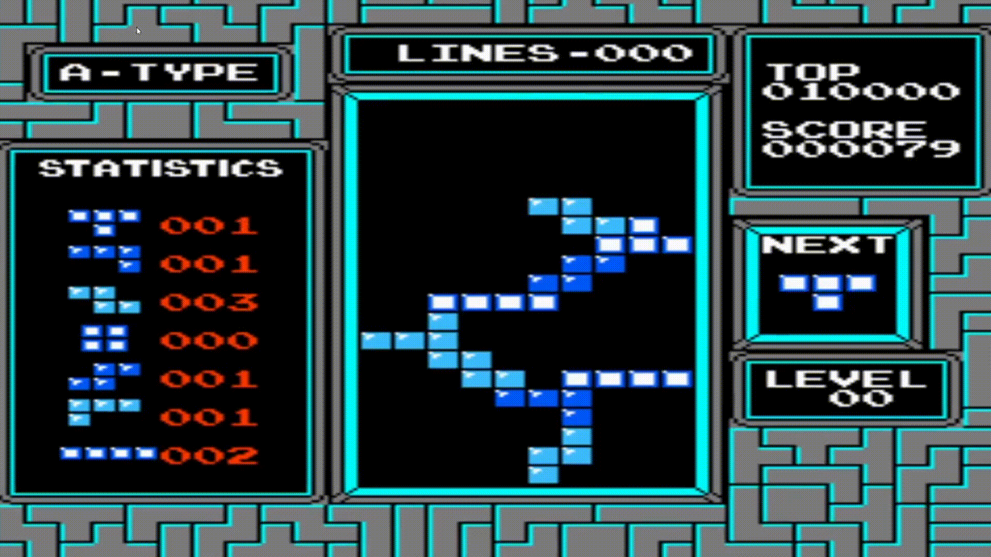
Baseline Model Sample

Slide 7
Baseline Results Alpha of 0.001
Game | Score (Game 1)
1 | 92
2 | 112
3 | 101
4 | 92
5 | 108
6 | 105
7 | 89

Slide 8
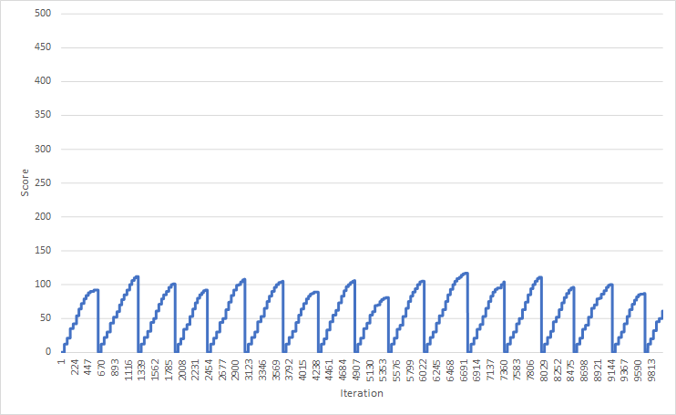
Graph of Baseline Results

Slide 9
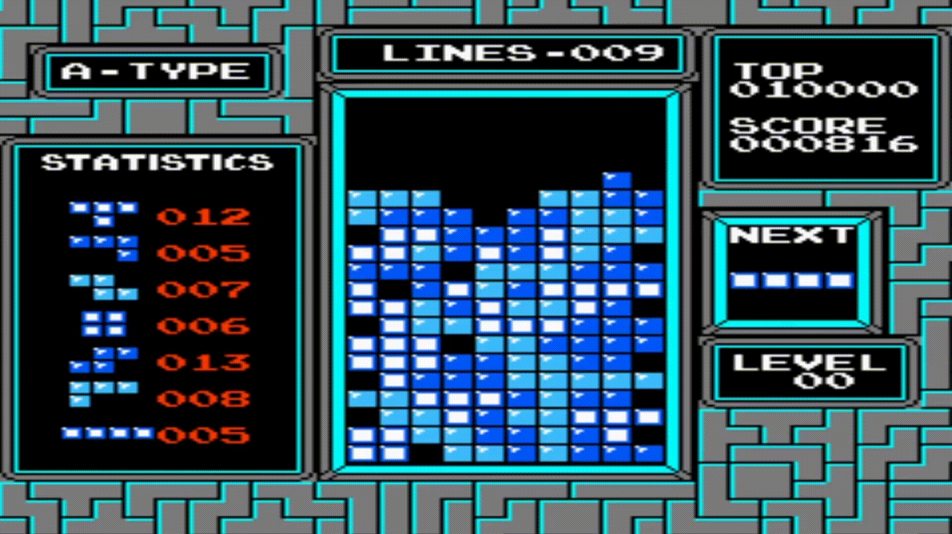
Best Model Sample

Slide 10
Best Model Results Alpha of 0.001
Game | Score (Game 1)
1 | 837
2 | 3137
3 | 2879
4 | 1766
5 | 5300
6 | 26906
7 | 763

Slide 11
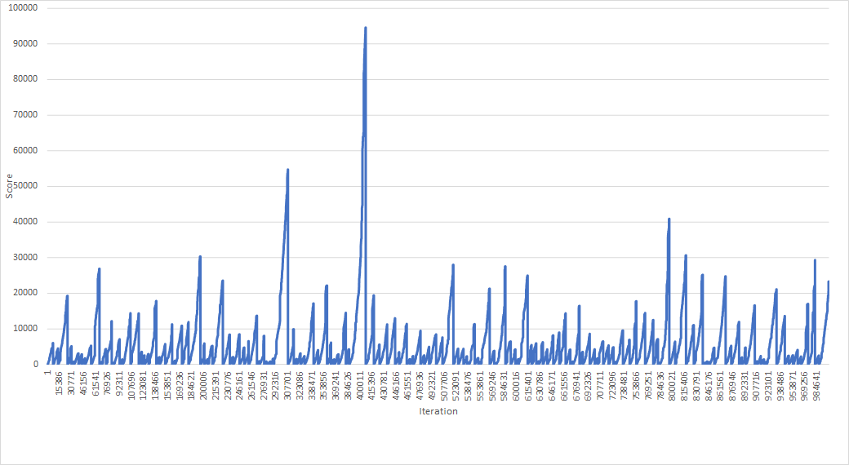
Graph of Best Results

Slide 12

Future Work
Notes:
Talk about what we would do with more time and resources

